Slide 1

NSRIC Inc. (Nature Science Research and Innovation Centre)
Ontario (ON), Canada
Online Education (OE) Division
Essentials of Marketing
Instructor: Kathy Chen
Marketing Program, OE Division
NSRIC Inc.
London, ON, Canada
E-mail: kathyjchen18@gmail.com
https://www.nsric.ca

Slide 2
Week 1: Customers and Competition
Content covered in this week:
Part I: Brief of this course (topics & assessments)
Part II:
1.1 Introduction to customer decision-making
1.2 Customer decision-making from a behavioral perspective

Slide 3
Week 1: Customers and competition
1.1 Introduction to customer decision-making
1. Stages in the consumer buying process
This lesson explains consumers' purchasing behaviors. First, it presents the rational decision-making process that customers go through when deciding to make a purchase. It concludes by exploring the factors based on the prospect theory that illustrate 'irrational' decision-making.
We need to recognize that a consumer is a person who actually uses the product or service, while a customer is one who purchases it. The customer may not themselves be the consumer.
For example, a mother buying kids’ toothpaste for a child is the customer, but the child is the consumer. Having said that, we will use the words consumer and customer interchangeably in this module because that is what tends to happen in the real business world.

Slide 4
Week 1: Customers and competition
1.1 Introduction to customer decision-making
1. Stages in the consumer buying process
However, do take note of this difference and use the two words as appropriate when required.
One of the central questions for marketers is: how do consumers respond to various marketing efforts that a company might use? Thus, it's important for us to study consumer buying behavior.

Slide 5
Week 1: Customers and competition
1.1 Introduction to customer decision-making
The consumer buying process
Generally speaking, the consumer’s buying process involves five steps that we will summarize in this section. You can also read about these in more detail in Chapter 6 of Marketing Management. The steps are: problem recognition, information search, evaluation of alternatives, purchase decision and post-purchase behavior.
Step 1: Problem recognition: perceiving a need
You perceive the need for the particular product or service. For example, if you were looking on the market for a laptop, what you would most likely do first is realize that you need to buy a laptop.

Slide 6
Week 1: Customers and competition
1.1 Introduction to customer decision-making
The consumer buying process
Step 2: Information search: seeking value
You go and find out about the things that you would like for your laptop, for example: what are the existing brands in the market? Do you want something that is really slim or that has a large screen? Do you want more RAM or do you need more storage? What are the prices? And so on.
Step 3: Evaluation of alternatives: assessing value
You start evaluating alternatives, i.e., you compare different products.

Slide 7
Week 1: Customers and competition
1.1 Introduction to customer decision-making
The consumer buying process
Step 4: Purchase decision: buying value
Eventually, you decide which product you would like, and you make a purchase decision.
Step 5: Post-purchase behavior: value in consumption or use
At the post-purchase stage, you might be satisfied or dissatisfied with the product, and depending on how you feel about it, you will decide to talk about it positively or negatively. If you are happy with it, you may rebuy the product.

Slide 8
Week 1: Customers and competition
1.1 Introduction to customer decision-making
2. Information search and search dynamics
When a person looks for information, they go through advertisements and other material put out by brands and other agencies about it. Sometimes they find information in the public domain if the government is making announcements, or in more recent times, on social media.
If you have had an experience with a particular product or service, you put that memory into play and this is where you get the information from. It doesn't have to be a fancy product. For example, if you like the taste of toothpaste as an experiential thing, and that is information that is stored, then you will bring it to this particular decision-making situation.

Slide 9

Week 1: Customers and competition
1.1 Introduction to customer decision-making
2. Information search and search dynamics
Search dynamics: buying a laptop
The following example explains in detail the dynamics of this information search. You can find this example in Chapter 6 of Marketing Management.
Total set of brands
When we start doing the information search, we
start with a whole big set of brands. Let us make
it simpler; say you are looking on the market for
a laptop. There's Hewlett-Packard, Lenovo, Sony,
Apple, etc. The set of all brands for this product
will form the total set. All possible brands of
laptop will constitute the total set.

Slide 10

Week 1: Customers and competition
1.1 Introduction to customer decision-making
2. Information search and search dynamics
Awareness set
As a customer, you may not be aware of all of these brands but only some of them. This set is called the awareness set (blue, highlighted area), a subset of the total set. The awareness set is made up of the brands that the customer knows about.

Slide 11

Week 1: Customers and competition
1.1 Introduction to customer decision-making
2. Information search and search dynamics
Consideration set
This is a subset of the awareness set. It is formed of the brands that the consumer will actually consider as possible choices. For example, if I am a Windows user, even though Apple exists as a brand in the total set and in my awareness set, I may not consider it in my purchase decisions. Therefore, Apple is excluded (see red area with
thick border) from my consideration set.

Slide 12

Week 1: Customers and competition
1.1 Introduction to customer decision-making
2. Information search and search dynamics
Choices set
Finally, we have the choice set (green area with dashed border). If I buy one item, that's the choices set. The choice set is made up of the products purchased.

Slide 13
Week 1: Customers and competition
1.1 Introduction to customer decision-making
3. Influences on purchase decisions
Types of influences
Purchase decisions can be influenced by marketing. If one is familiar with a brand and then sees another product with the same brand name, that may affect their purchase decision. Usually, more brand-loyal customers will continue to purchase the brand they are loyal to.
Promotions, such as advertisements, etc., will impact choice, the location or place where the product is being sold – for example, online versus offline – will affect choice, and the price will affect choice: something at full price may not be purchased, while the same item on sale may be purchased.

Slide 14
Week 1: Customers and competition
1.1 Introduction to customer decision-making
3. Influences on purchase decisions
The next set of influences is psychological influences. For instance, what is the motivation for you to make that particular purchase? What type of personality do you have? What is your lifestyle? etc.
The third kind is socio-cultural influences. For example, are you influenced by the decisions of friends and family? You want to belong to a group, and therefore, you are likely to purchase certain items.
The last set of influences is situational influences. Let’s illustrate this with some examples.

Slide 15
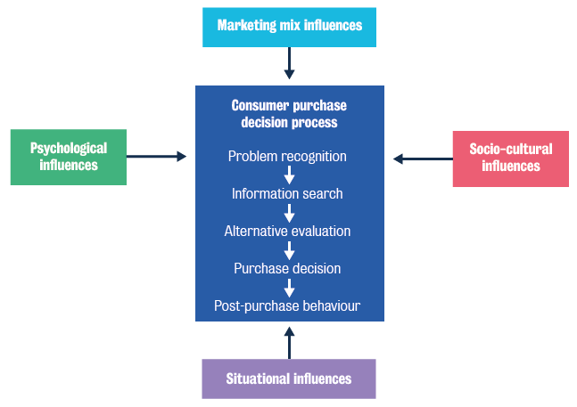
Week 1: Customers and competition
1.1 Introduction to customer decision-making

Slide 16
Week 1: Customers and competition
1.1 Introduction to customer decision-making
4. Situational and psychological influences on purchase decisions
Situational influences
Situational influences include:
purchase task
social surroundings
physical surroundings
temporal effects
antecedent states.

Slide 17

Week 1: Customers and competition
1.1 Introduction to customer decision-making
To give you an example of a situational influence, think about a bottle of wine or a box of chocolates. These could be for yourself, or you could be buying them as a gift or as something to sell later (ie, for resale). Each of these depends on what you were buying it for, so the situation itself will change: how much you are willing to pay, how you evaluate the particular product, what is in your consideration set, etc. You may want to buy very expensive wines if you plan to resell them later,
but if the wine is for your own consumption, that
expensive wine may not be in the set of
alternatives you will consider.

Slide 18
Week 1: Customers and competition
1.1 Introduction to customer decision-making
The strong effect of social surroundings
Another example of situational influence – and this is very interesting – is that even if there is no human being present, the situation affects the purchase. An experiment was conducted where a coffee club simply had a sign which asked people to put money in the box for whatever they took (Bateson et al. 2006). See the picture on the next slide.

Slide 19
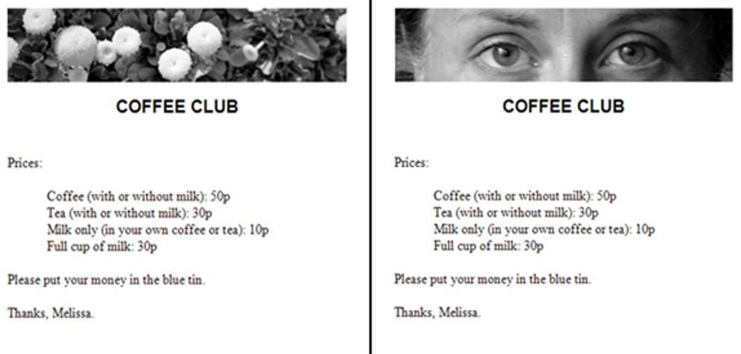
Week 1: Customers and competition
1.1 Introduction to customer decision-making
Attribution: Mackenzie. D (2006). ''Big Brother' eyes make us act more honestly', NewScientist

Slide 20
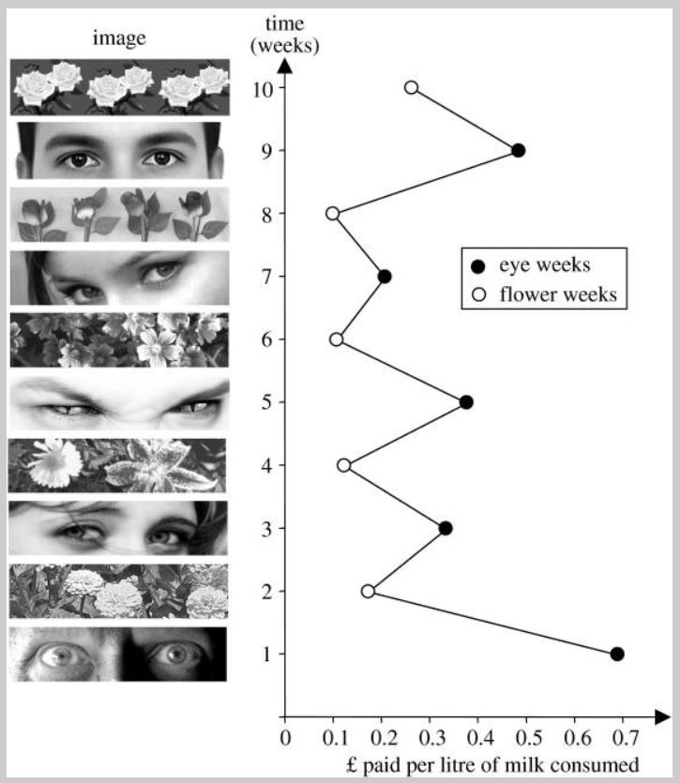
Week 1: Customers and competition
1.1 Introduction to customer decision-making
In one situation, they had pictures
of flowers, and in the other situation,
the picture was of human eyes. It
consistently turned out that the
simple presence of a photo of eyes
made people pay more for a cup of
tea or coffee. Thus, the situational
influences of social surroundings
are extremely strong.

Slide 21
Week 1: Customers and competition
1.1 Introduction to customer decision-making
Psychological influences: the effects of independent vs interdependent selves
Psychological influences include:
Motivation
Personality
Perception
learning values, beliefs and attitudes
lifestyle

Slide 22
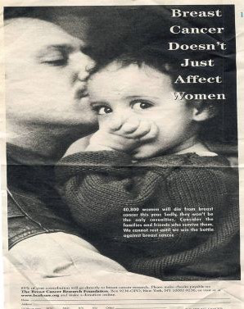
Week 1: Customers and competition
1.1 Introduction to customer decision-making
To illustrate some psychological influences, think about two advertisements where one talks about the independent self and another of the interdependent self. Look at these particular pictures:
Interdependent self
This ad says that breast cancer doesn’t just affect women. This means that it’s all about interdependence, as in the picture there is a child, and possibly a partner, who will also be affected.

Slide 23

Week 1: Customers and competition
1.1 Introduction to customer decision-making
To illustrate some psychological influences, think about two advertisements where one talks about the independent self and another of the interdependent self. Look at these particular pictures:
The consequences of the message will be different based on how such psychological influences affect the consumer.
Independent self
This other type of ad says that five million Americans have hepatitis. This is focused on the independent person.

Slide 24
Week 1: Customers and competition
1.1 Introduction to customer decision-making
5. Marketing and socio-cultural influences on purchase decisions
Marketing mix influences
Marketing mix influences include:
product
price
promotion
place.
Think of product influences: if you are looking for any particular product, even for something as mundane as a rubbish bin, you might suddenly find that a new feature starts to affect how you think about your purchase. For example, you might discover that touch-free rubbish bins are available, using sensors. Now, the fact that there is a particular brand providing these will actually change the way you evaluate the other products: you may never buy this new bin, but the fact that it exists will influence how you evaluate the other bins and, therefore, your purchase decision.

Slide 25
Week 1: Customers and competition
1.1 Introduction to customer decision-making
When you think about other marketing mix influences, think about where the product is being sold: if you require something while at the airport, if you'll carry it home; even something as simple as a bag. These factors are likely to influence the purchase process.
Socio-cultural influences
Socio-cultural influences include:
personal influence
reference groups
family
social class
culture
subculture.

Slide 26
Week 1: Customers and competition
1.1 Introduction to customer decision-making
Please read the extracts below for further information on socio-cultural influences.
"A person’s reference groups are all the groups that have a direct (face-to-face) or indirect influence on their attitudes or behavior. Groups having a direct influence are called membership groups. Some of these are primary groups with whom the person interacts fairly continuously and informally, such as family, friends, neighbors, and coworkers. Reference groups influence members in at least three ways. They expose an individual to new behaviors and lifestyles, they influence attitudes and self-concept, and they create pressures for conformity that may affect product and brand choices."
From Kotler and Keller, Marketing Management.

Slide 27
Week 1: Customers and competition
1.1 Introduction to customer decision-making
Please read the extracts below for further information on socio-cultural influences.
A specific example of socio-cultural marketing influences can be found in Woodhouse’s (2019) Financial Times(opens in a new tab) article. Annie Hou, vice-president of strategy at marketing agency Ogilvy in Beijing, describes the following changes in consumer attitudes.
Millennials [in China] express themselves and shape their personal image through luxury goods, [Hou] says, and they are starting to open up to Chinese brands. “In their mind, domestic brands are no longer inferior to global brands,” she observes. One reason behind the shift is that China’s economic rise over the past decade has fueled a sense of national pride among its youth.
From Woodhouse, A. (2019). China’s young luxury consumers warm to homegrown brands. Financial Times.

Slide 28
Week 1: Customers and competition
1.2 Customer decision-making from a behavioral perspective
1. The influence of prospect theory in the evaluation of alternatives
Up until now, we have been discussing how consumers make rational purchase decisions. We multiplied the weights we attach to certain attributes, added them up and came up with choices. In this section, we will explore the impact that psychological research into economic sciences and human judgement and decision-making under uncertainty can have on purchasing decisions.
We will now discuss what is known as prospect theory, for which a Nobel prize was awarded to Dr Daniel Kahneman in 2002. Prospect theory, as suggested by Daniel Kahneman and Amos Tversky, says that we are affected by gains and losses. The theory suggests three main ideas:
changes are with respect to reference points
losses feel larger than gains
the marginal effect on the value gets smaller as the amount of loss or gain increases.

Slide 29
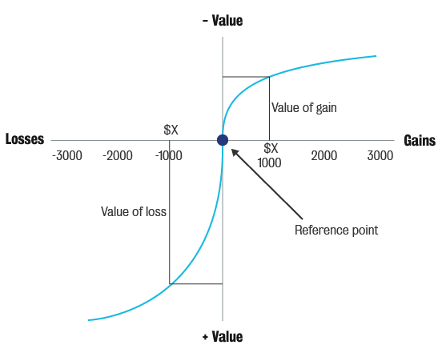
Week 1: Customers and competition
1.2 Customer decision-making from a behavioral perspective
Look at the following diagram:

Slide 30
Week 1: Customers and competition
1.2 Customer decision-making from a behavioral perspective
Losses feel larger than gains
Let’s start with the simplest idea: ‘losses feel larger than gains’. If you look at the picture, the loss function on the lower left-hand side is steeper than the gain function on the right-hand top quadrant.
Simply put: if you were to lose a dollar, it would hurt you a lot more than gaining a dollar would increase your happiness. The marginal effect on the value gets smaller as the amount of loss or gain increases.

Slide 31
Week 1: Customers and competition
1.2 Customer decision-making from a behavioral perspective
Secondly, if you look at the right-hand top section of the graph, which is the gain curve, it shows that we feel less strongly as we gain more money. If we gain from $0 and $1000, we feel very happy, but from $1000 to $2000, and $2000 to $3000, our happiness still increases, but not to the degree of the original $1000. Similarly, if we lose $1000, we feel extremely sad, but then between $1000 and $1200, and then $1500, and $2000, we still feel the pinch but not as much as losing the first $1000.
In short, both gain and loss taper out in the value they provide, whether it is negative value or positive.

Slide 32

Week 1: Customers and competition
1.2 Customer decision-making from a behavioral perspective
2. Evaluation of alternatives: behavioral decision theory
Consumer decision-making: ‘irrational' decisions
Based on prospect theory, there are things that happen in the evaluation of alternatives. Some of the ways in which we as consumers and customers make our decisions are not always rational in the sense of the expectancy-value model. Instead, we make what are 'seemingly irrational’ decisions. The following cognitive biases explain these kinds of decisions:
Availability heuristic
Availability heuristic judgements are essentially
quick and easy choices. Our evaluation might be
based on the most recent product that we have
used or one that we have seen an ad for.

Slide 33
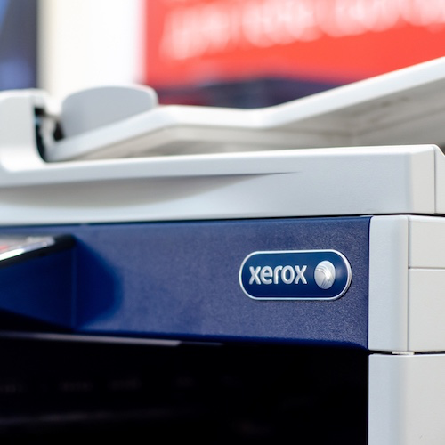
Week 1: Customers and competition
1.2 Customer decision-making from a behavioral perspective
Representativeness heuristic
This is where consumers base their predictions on how representative or similar the outcome of something is to an example they are familiar with. For example, in the photocopier market, this might be Xerox for some people, or Samsung for others. While they might be considering a different brand of copier, they might still think of that other brand in terms of a Xerox or Samsung. Similarly, for a lot of people, a vacuum cleaner is a Hoover. People say they are buying a Hoover when they
might actually be buying another brand of vacuum
cleaner – ie, they are treating Hoover as
representative of the category.

Slide 34
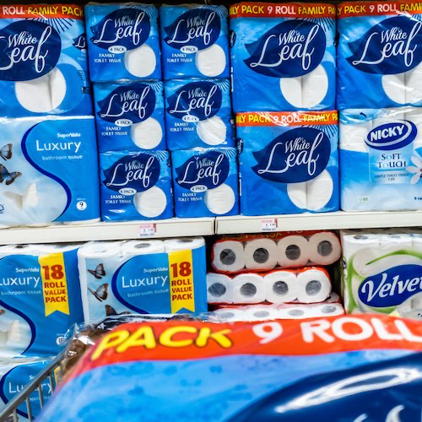
Week 1: Customers and competition
1.2 Customer decision-making from a behavioral perspective
Anchoring
We can illustrate the notion of anchoring based on a real experiment: in a grocery store, toilet paper was being sold at $0.50 per roll or at four rolls for $2. The store made the four salient, thus anchoring the decision process to focus on four.
In terms of pure economics, if a person bought four rolls, the cost was still $0.50 per roll of toilet paper, but due to the fact that the product was anchored with the number four, consistently more
people bought four rolls for $2 than paid $0.50 per
roll. To sum up, the price itself did not matter, it was the same, but how people processed it made a difference to the
purchase.

Slide 35

Week 1: Customers and competition
1.2 Customer decision-making from a behavioral perspective
Framing
Framing is about the way that we present our message and how it affects consumers’ reaction towards our message. For example, in anti-smoking campaigns, marketers have to ask themselves: do you want to frame the message in terms of a loss in health, or do you want to make it a gain? It seems that with anti-smoking ads it is loss framing that works particularly well: loss of health, ill-health, loss of life, etc.
makes people decide differently and more
effectively than a gain message.

Slide 36
Week 1: Customers and competition
1.2 Customer decision-making from a behavioral perspective
3. Evaluation of alternatives: mental accounting
This is a theory proposed by Richard Thaler, who also won a Nobel Prize for this kind of work. Some of the key ideas are the following:
Segregate gains and aggregate losses
We, as customers, like segregating gains and aggregating losses. For example, if one person wins two lotteries of $25 each, versus another who wins one lottery of $50, who do you think is happier? It turns out that winning two lotteries of $25 makes us happier, even though both sum up to $50. So, it seems that we prefer to have more little gifts than one large one. If you are a marketing manager, when thinking of gains for the customer, think about adding a little bit more but separating those little gains rather than putting them into the same box. In contrast, when thinking of losses, consider aggregating them. For example, with our credit card bills we prefer to have everything at once. We do not like to see one charge, and then another charge, and then another charge. Having a bill all in one go makes us less unhappy.

Slide 37

Week 1: Customers and competition
1.2 Customer decision-making from a behavioral perspective
3. Evaluation of alternatives: mental accounting
Price increase versus quantity decrease
Observe how people perceive price increases versus a quantity decrease.
This is an interesting situation because it is also related to how people buy if they read the per-unit price of a product. Therefore, marketers can play around by giving the same quantity and increasing the price, or by reducing the price and reducing the quantity at the same time.
For example, confectionery producers decrease the
quantity or weight of chocolate bars or biscuits to
keep the package price the same, but the price per
gram increases. How people perceive the two is
dictated by differences in how we mentally account
for each of those.

Slide 38
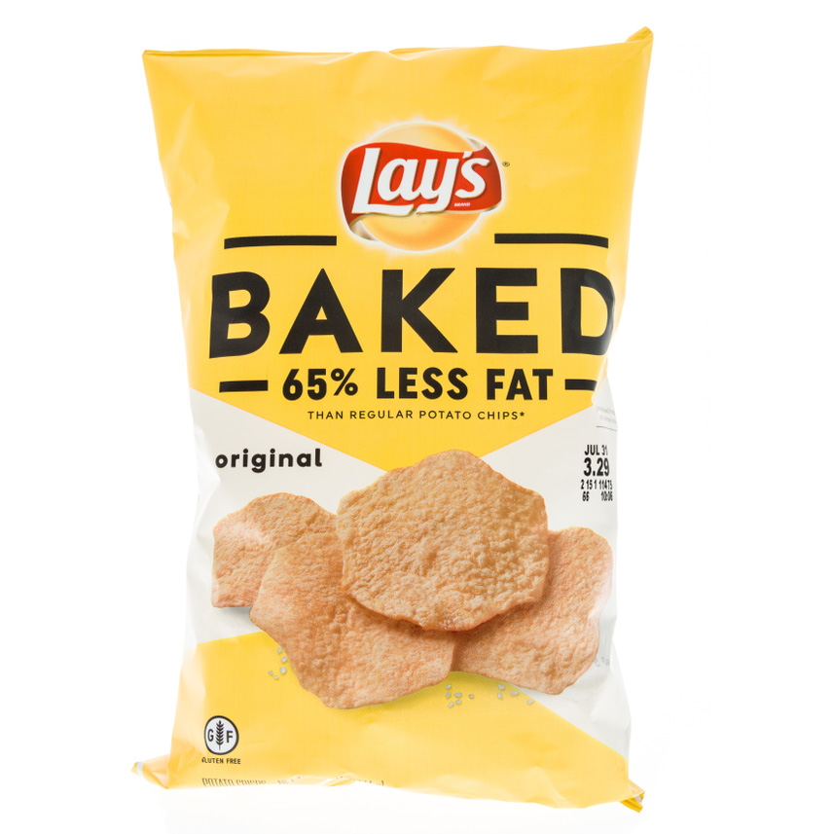
Week 1: Customers and competition
1.2 Customer decision-making from a behavioral perspective
3. Evaluation of alternatives: mental accounting
Labels on products
Another interesting example is labels on groceries. Labelling a meat 75% lean versus 25% fat will make a difference to how we purchase it. The product still contains the same percentage of fat, but, as a marketer, labelling it 75% lean is still factually correct and you will sell more.

Slide 39
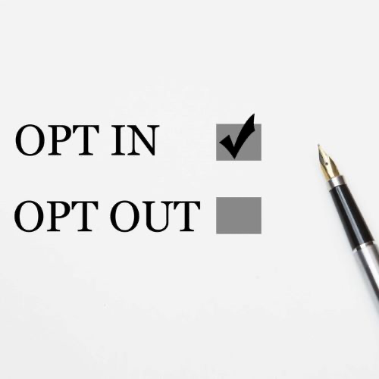
Week 1: Customers and competition
1.2 Customer decision-making from a behavioral perspective
3. Evaluation of alternatives: mental accounting
Loss aversion
Another aspect to consider is loss aversion. Think about how many times you visit a website and leave a bookmark. This is because we are loss averse and we generally choose the status quo.
This point is well-illustrated in some parts of the world where organ donation upon death is automatic. Consistently, countries
that have the opt-out option of organ donation have
more donors than the opt-in countries because
generally people on each type simply keep to the
status quo. Essentially, whether we have to opt in
or not makes a difference to how we make a
decision.

